Slide 1

Think Like The Cardinality Estimator
Taiob Ali
June 24 2020
Think Like The Cardinality Estimator
Notes:
Tell name

Slide 2


Taiob Ali
Data Professional
Microsoft Data Platform MVP. 14 Years working with Microsoft Data Platform. Microsoft and MongoDB certified. Worked in ecommerce, healthcare and finance industry.
Giving Back
Data Solutions Manager, GMO LLC
Board member NESQL user group and PASS DBA virtual group. Organizer of Boston SQL Saturday. Frequent speaker at local and virtual user groups, SQL Saturdays, and azure events.
http://sqlworldwide.com/
When Not Working
/sqlworldwide
Running – One 26.2 and many 13.1 miles. Learning US history. Shuttling 3 kids.
@sqlworldwide
Taiob@sqlworldwide.com

Slide 3
Predicate, Density, Predicate Selectivity
What is Cardinality
Why Cardinality Matters
DBCC SHOW_STATISTICS
Magic Numbers
@SQLWorldWide
Notes:
Why did I pick up these things
All of these elements are used as input for the cardinality estimator in making decision about the estimated rows
Among these items statistics are a big part and that is why we will spend a fair amount of time looking at DBCC show_statistics output
All code and slide available –show them solution
I tested all of these in 2017 CU20, SSMS 18.5
Resource page

Slide 4
Predicate
Is an expression that evaluates to
TRUE, FALSE, or UNKNOWN
Join
Filter
Where
Having
@SQLWorldWide
Notes:
Predicate
Why we are talking about predicate
The cardinality estimation process are interested in the predicates you define
Logical expression which evaluates to TRUE, FALSE or UNKNOWN
2 types
Join predicate used in join
Filter Predicate used in where and having clause

Slide 5
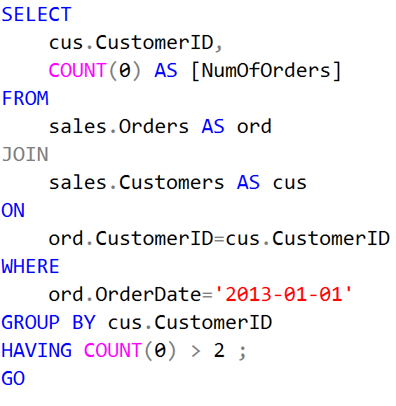
Join Predicate
Filter Predicate
Where/Having
@SQLWorldWide
Notes:
Why using count(0) and not using (*)
Predicate
Logical expression which evaluates to TRUE, FALSE or UNKNOWN
join
Filter:
where
having

Slide 6
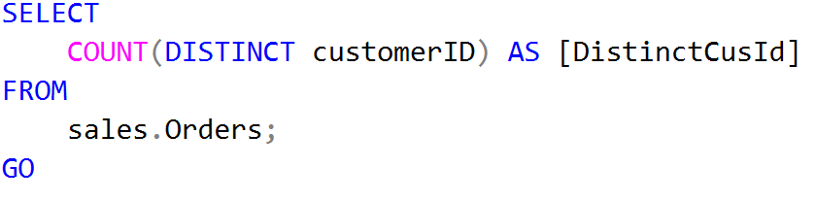
Density
How often duplicate values occur in a column.
1
__________________________________
[# of distinct values in a column]
Density
663 distinct customerID
1/663=0.00150830
@SQLWorldWide
Notes:
Density, when used to describe the data in a column, is a measure of how often duplicate values occur in that column.
Defined as 1/unique values
Higher-less unique
Lower-More unique

Slide 7
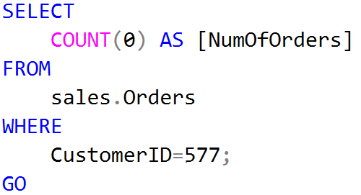
Predicate Selectivity
Most commonly used to describe a predicate.
[ # rows that pass the predicate ]
__________________________________
[total number of rows]
75 rows for customerID 577
73595 total number of rows.
75/73595=.0010
@SQLWorldWide
Notes:
We talked about predicate, cardinality estimator have to determine how selective each predicate is
Predicate selectivity has a very high implication as we will see during the entire presentation.
Selectivity used to describe a predicate.
Most selective predicate will have less number of rows qualified
The estimated selectivity of a predicate is essential
will affect things like join order (all other things equal, the most selective join operation is generally performed first)
whether SQL chooses to do a table scan or an index seek followed by a bookmark lookup.
Selectivity for a filter predicate against a base table can be calculated as “[# rows that pass the predicate]/[# rows in the table]”.

Slide 8
Cardinality
For Us
Structured Query Language
Math
Uniqueness of data values contained in a particular column (attribute) of a database table.
Cardinality of a set is a measure of the “number of elements of the set”.
Number of rows returned by a query operator.
@SQLWorldWide
Notes:
Similar to what I explained for density.
The lower the cardinality, the more duplicated elements in a column. Thus, a column with the lowest possible cardinality would have the same value for every row. SQL databases use cardinality to help determine the optimal query plan for a given query.

Slide 9
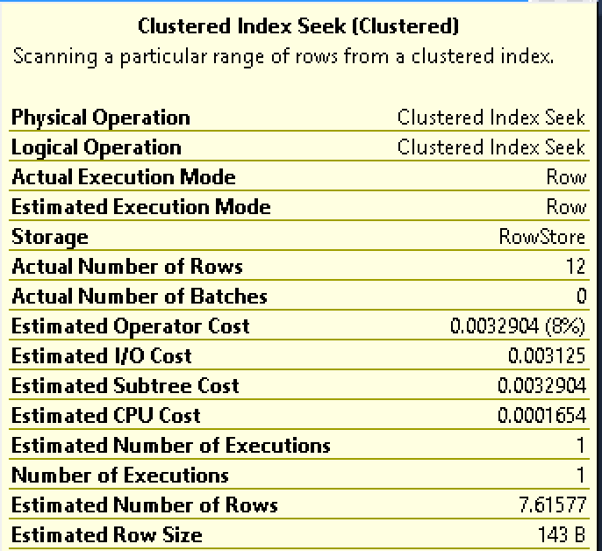
Actual
Estimated
@SQLWorldWide
Notes:
cardinality can be thought of as the number of rows returned by a query operator.
Actual vs Estimated
You want to validate how good or bad the estimate is.
In order to do that you need to know what formula the estimator is using.

Slide 10
Why Cardinality Matters?
Parse
+
Normalize
Cardinality Estimation
Downstream
Optimization
Downstream
Execute Plan
Before
Derive Cardinality
+
Create Many Plans
@SQLWorldWide
Notes:
Parse-check syntax, spelling, use of correct key words
Normalize-binding (checking weather tables or columns exist), change view with the definition, subquery replaced with join

Slide 11
Why Cardinality Matters?
Cost
Parallel
Memory Grant
In Memory
Access Method
Seek
Algorithm
Aggregate
Sort
Spill to Disk
Scan
Seek + Scan
Serial
Join
@SQLWorldWide
Notes:
Join
Nested
Hash
Merge
Aggregate
Stream
Hash
Sort
In memory
tempdb

Slide 12
DBCC SHOW_STATISTICS
Header
Density Vector
Histogram
How many unique values are present within a column or columns?
Frequency of data within the first key column of the statistics.
Meta data about the statistics.
@SQLWorldWide
Notes:
Statistics is a big part of cardinality estimation. Lets look at details.
Header=metadata about statistics
Density Vector = Measure cross-column correlation
Histogram = 200 steps max, distribution of value in the first key column of the statistics object

Slide 13

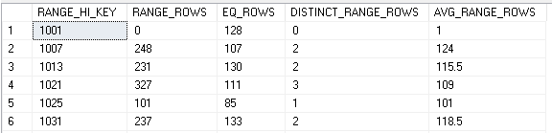
STAT_HEADER
DENSITY_VECTOR
HISTOGRAM
@SQLWorldWide
@SQLWorldWide
Notes:
We will look at all 3 piece in details
Header=metadata about statistics
Density Vector = Measure cross-column correlation
Histogram = 200 steps max, distribution of value in the first key column of the statistics object

Slide 14
STAT_HEADER
Deprecated
@SQLWorldWide
Notes:
Header=metadata about statistics
Density Vector = Measure cross-column correlation
Histogram = 200 steps max, distribution of value in the first key column of the statistics object

Slide 15
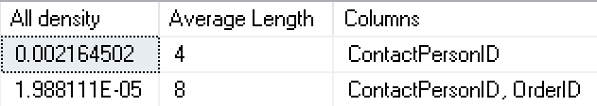
DENSITY_VECTOR
1/Number of distinct values in column
Names of columns in the prefix
@SQLWorldWide
Notes:
ContactPersonId interger

Slide 16
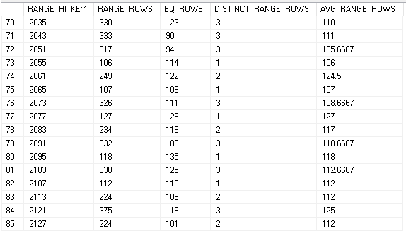
Histogram
@SQLWorldWide
Notes:
ContactPersonId interger

Slide 17
RANGE_HI_KEY | RANGE_ROWS | EQ_ROWS | DISTINCT_RANGE_ROWS | AVG_RANGE_ROWS
2083 |  | 119
Between 2084 and 2090 | 332 |  | 3 | 110.66
2091 |  | 106
@SQLWorldWide
Notes:
# of rows can be estimated if it is sample and depending on when it was last updated
Select distinct ContactPersonID from sales.orders
where ContactPersonID>2083
and ContactPersonID<2089
--2
Select * from sales.orders
where ContactPersonID=2089
--111

Slide 18

Single Predicate
Histogram direct hit
Histogram intra step
Scaling
Distinct
@SQLWorldWide
Notes:
We will see how do we get these numbers

Slide 19
Multiple Predicates
Conjunction
Disjunction
Parameter Sniffing
Unknown
Ascending Key
@SQLWorldWide
Notes:
We will see how do we get these numbers

Slide 20

SQL2019 CU5
SSMS 18.5.1
https://www.invotide.com/demo
@SQLWorldWide
Notes:
Talk about tools
SQL2019 CU5
SSMS 18.5.1

Slide 21
Resource
Query Tuning Fundamentals
DBCC SHOW_STATISTICS (Transact-SQL)
13 Things You Should Know About Statistics and the Query Optimizer
Cardinality Estimation for Multiple Predicates
New Trace Flag to Fix Table Variable Performance
Ascending key Issue TF 2389 and 2390
Optimizing Query Plans with the SQL Server 2014 Cardinality Estimator
@SQLWorldWide
6/25/2020

Slide 22




@SqlWorldWide
linkedin.com/in/sqlworldwide
sqlworldwide.com
taiob@sqlworldwide.com
6/25/2020
@SQLWorldWide

Slide 23


